Slide 1
SOLITAIRE CARD GAME
RAGHUL N
11/09/24

Slide 2
AIM OF THE PROJECT
To Implement a functional Solitaire game using Python's OOP concepts.
To Enable card movement and game state management.
To Ensure user-friendly interaction with input validation.
To handling error for smooth gameplay.

Slide 3
PROBLEM SATEMENT
Develop a Solitaire Game
Implement Card and Deck Management
Facilitate User Interaction
Ensure Input Validation and Error Handling
Support Dynamic Game Updates

Slide 4
PROJECT DESCRIPTION
Object-Oriented Design
Card and Deck Management
User Interaction
Input Validation and Error Handling
Real-time Game Updates.

Slide 5
FUNCTIONALITIES
1.Card Class
def __init__(self, suit, value):
Method initializes each card with
two attributes(suit, value).
def __repr__(self):
Method returns a string representation
of the card, e.g., "Ace of Spades",
2.Deck Class
def __init__(self):
Method initializes the deck, creating a list
for cards, and defines possible suits and values.
def shuffle(self):
The shuffle() method shuffles the cards
list randomly using Python’s built-in
random.shuffle().
def deal_card(self):
The deal_card() method removes and returns the last card from the cards list (the "top" card).
3. Solitaire Class
def display_columns(self):
The display_columns() method prints out each column of cards in the game, listing cards in each column.

Slide 6
FUNCTIONALITIES
def display_foundation(self):
The display_foundation() method prints out
each of the 4 foundation piles.
def move_card(self, column1, column2):
The move_card() method moves a card from one column to another. The card is popped (removed) from column1 and appended to column2.
def move_to_foundation(self, column, foundation):
The move_to_foundation() method moves a card from a specific column to a foundation pile.
5.Game Setup
game = Solitaire()
A new instance of the Solitaire game is created.
game.display_columns()
game.display_foundation()
Initially displays the columns and foundation to show the current game state.

Slide 7
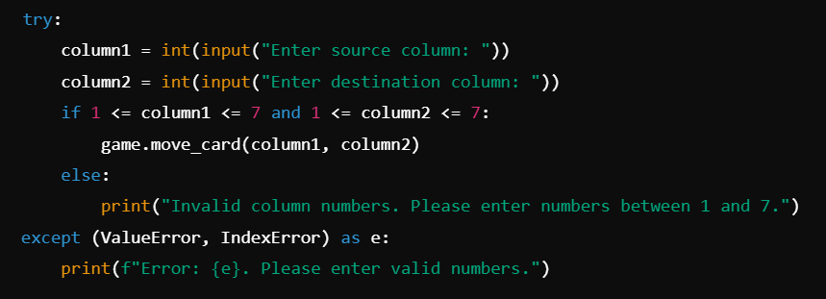
ERROR HANDLING
Try
Except
ValueError

Slide 8
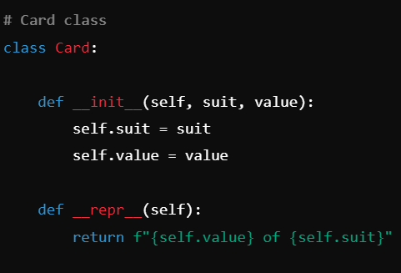
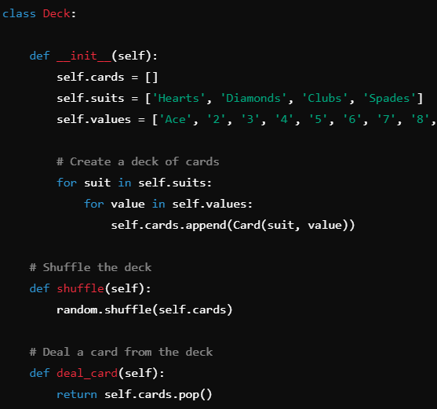
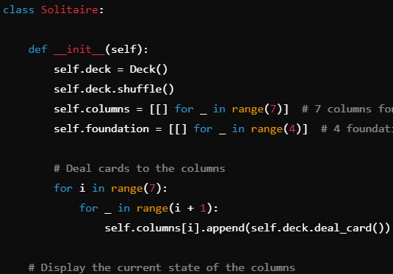
CODE IMPLEMENTATION

Slide 9
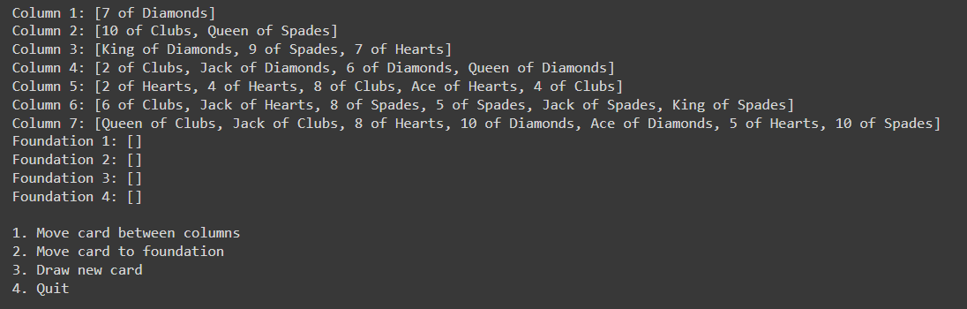
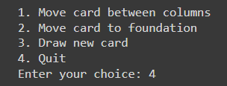
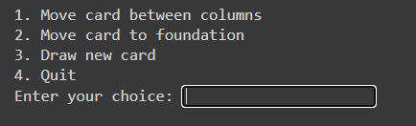
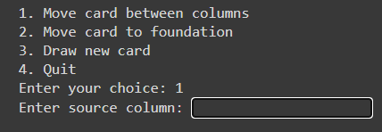
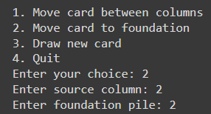
RESULT AND OUTCOME

Slide 10
CONCLUSION
Game Overview
Developed a basic Solitaire game with Python
Implemented core components: Deck, Card, and Solitaire classes
Key functionalities: shuffling, dealing, moving cards, and managing game state
Features Implemented
Card movement between columns and to the foundation
Drawing new cards from the deck
Displaying the current state of columns and foundations
Next Steps
Enhance user interaction with validation and error handling
Implement win/loss conditions for game completion
Add graphical interface for a more engaging experience
Reflection
Provided insights into object-oriented programming in Python
Demonstrated practical application of data structures and algorithms

Slide 11
Thank You!

Slide 12
Questions?

